Slide 1
Senior Infants in Lock Down

Slide 7
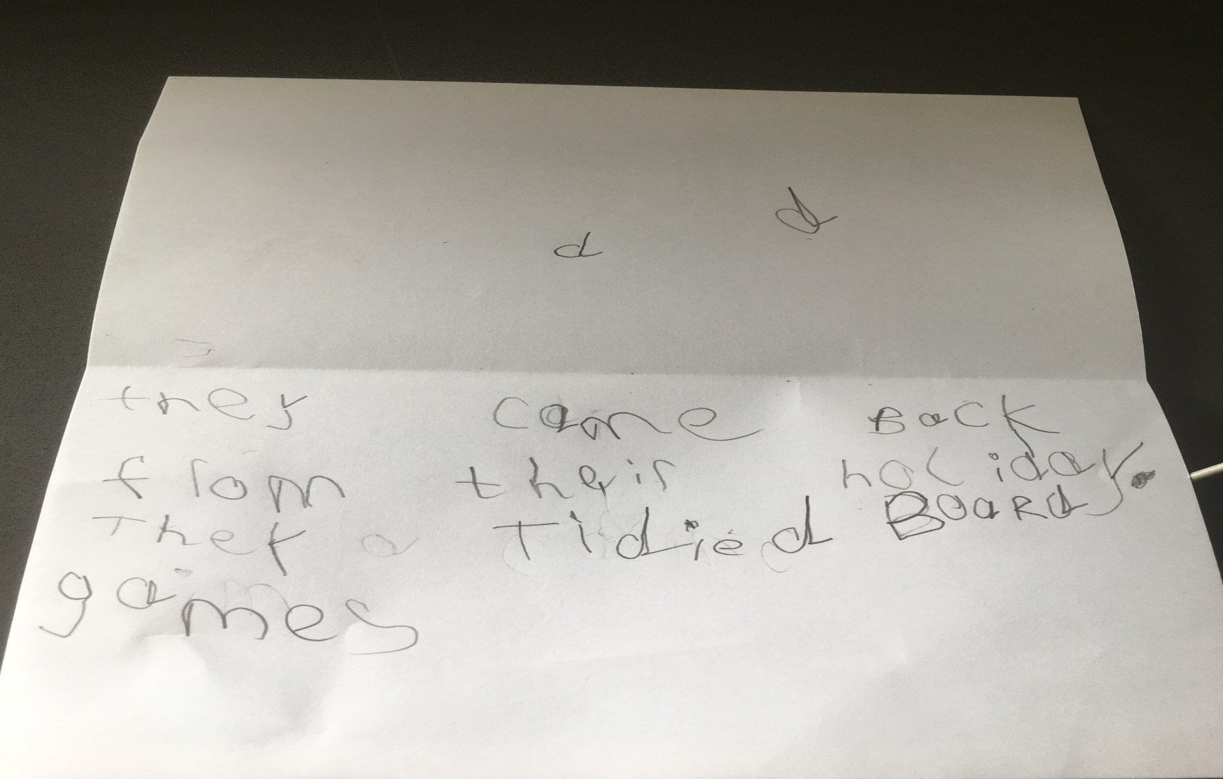

Slide 13
If you would like to see your work/or yourself next week..send me pictures and I will upload them here. Have a great week.
My email: gnsseniorinfants@gmail.com

